Slide 1

RATANMOTI
ADVANCE TEXTILE
BHARAT TEX 2026 · TECHNICAL TEXTILES KEYNOTE
Weaving Aramid Fibres
Engineering the limits of high-performance protective fabrics
PRESENTED BY
Ritesh · Ratanmoti Advance Textile
BHARAT TEX 2026 · ARAMID WEAVING
01 / 08

Slide 2
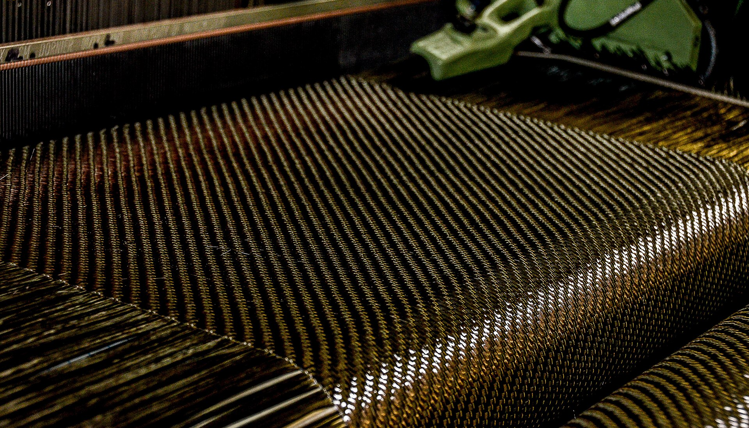
RATANMOTI
ADVANCE TEXTILE
THE PROBLEM SPACE · 01
If your product depends on aramid, the quality of its weaving is the quality of your product.
PARA-ARAMID
Strength & stopping power
Very high strength and stiffness — the fibre behind bullet-proof vests and armour.
META-ARAMID
Heat & flame resistance
Stays intact in fire and extreme heat — the fibre behind firefighter suits.
Ballistic armour
Firefighter kit
Aerospace
Filtration
Cut-resist gloves
High-strength ropes
BHARAT TEX 2026 · ARAMID WEAVING
02 / 08

Slide 3
RATANMOTI
ADVANCE TEXTILE
THE PROBLEM SPACE · 02
The loom must adapt to the yarn — not the other way round. Most suppliers never make that shift. We did.
Why Aramid Is So Hard to Weave
THE FIBRE…
…FIGHTS THE LOOM
Barely stretches (2–4%)
›
One small tension spike and the yarn snaps
Very stiff
›
Fights bending around every part of the loom
Slippery, high-friction surface
›
Rubs hard on metal and frays easily
Chemically inert
›
Ordinary sizing won't stick — it needs special coating
Brittle at sharp angles
›
Snaps where a normal yarn would simply bend
BHARAT TEX 2026 · ARAMID WEAVING
03 / 08

Slide 4
RATANMOTI
ADVANCE TEXTILE
THE PROBLEM SPACE · 03
Almost No Stretch — That Is the Whole Problem
Ordinary yarns (gold) stretch & forgive · High-performance fibres (teal) have no give
Wool
33%
Polyester
20%
Cotton
8%
Glass fibre
4.5%
UHMWPE
3.5%
Aramid
3.0%
Carbon fibre
1.6%
Ordinary yarn stretches and forgives. High-performance fibre does not — so there is no margin for error on the loom.
BHARAT TEX 2026 · ARAMID WEAVING
04 / 08

Slide 5
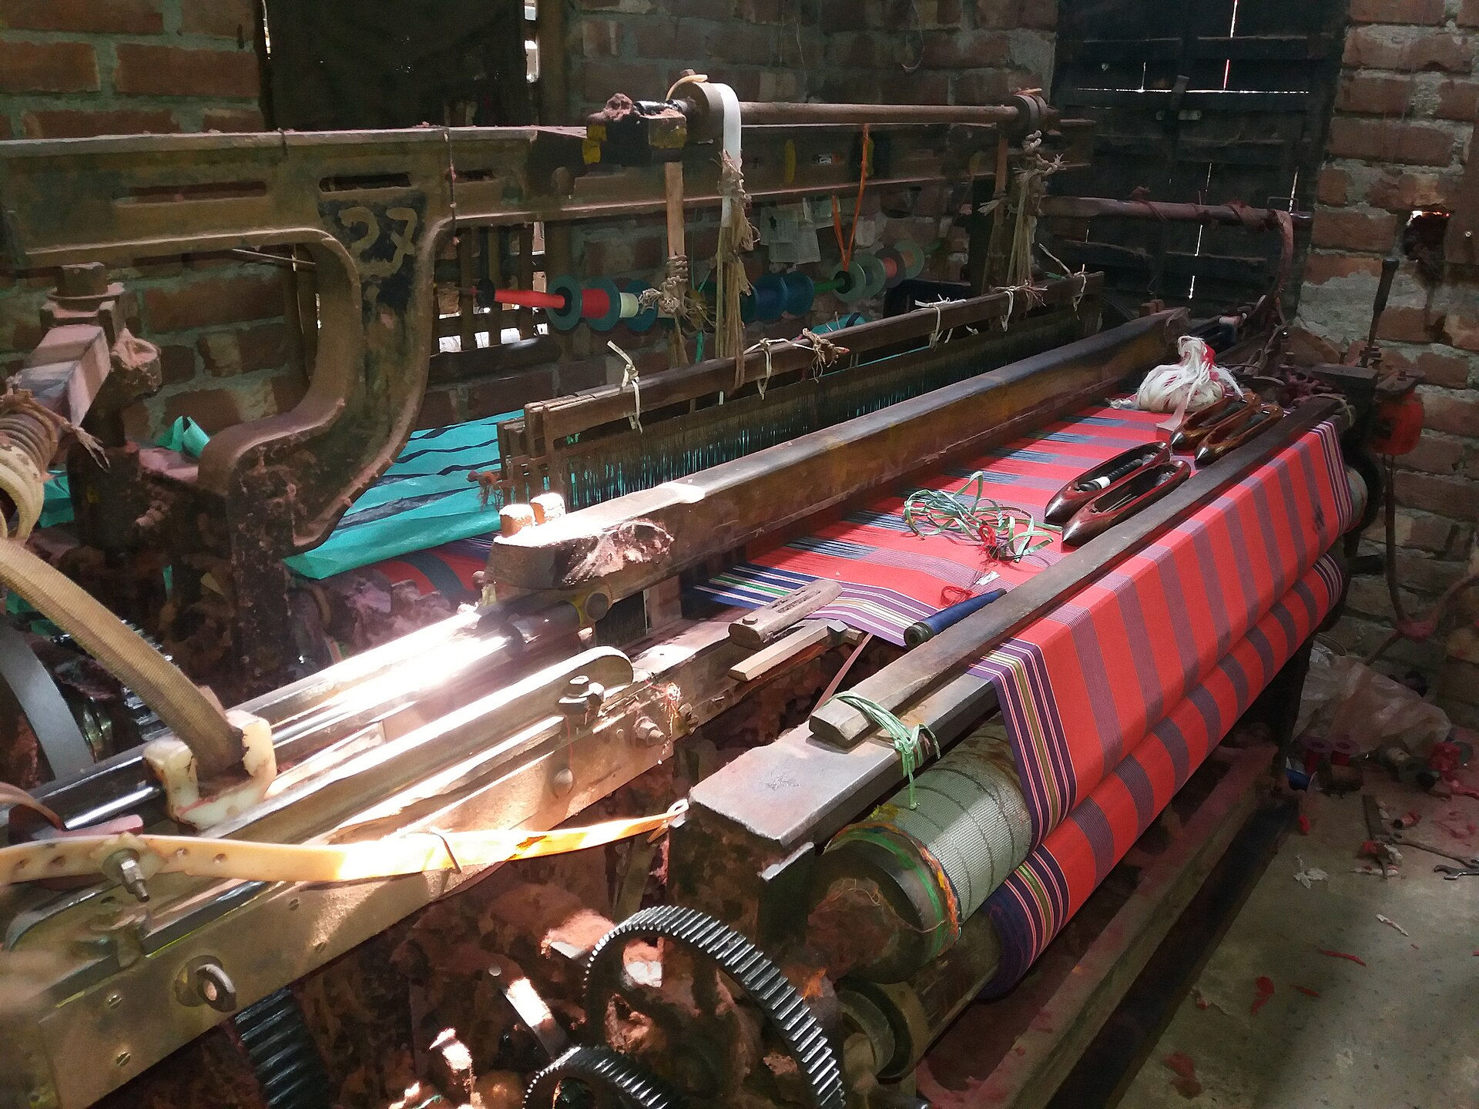
RATANMOTI
ADVANCE TEXTILE
THE PROBLEM SPACE · 04
Damage done on the loom is invisible there — it shows up later as your failure in the field.
Every contact point is a wear point.
HOW THE DAMAGE ADDS UP
Smooth yarn → tiny rubs → filaments split → surface frays. Tiny rubs pile up until the yarn loses its strength.
Stiff yarn fights every up-and-down of the loom — worst of all in dense, life-saving fabrics.
BHARAT TEX 2026 · ARAMID WEAVING
05 / 08

Slide 6
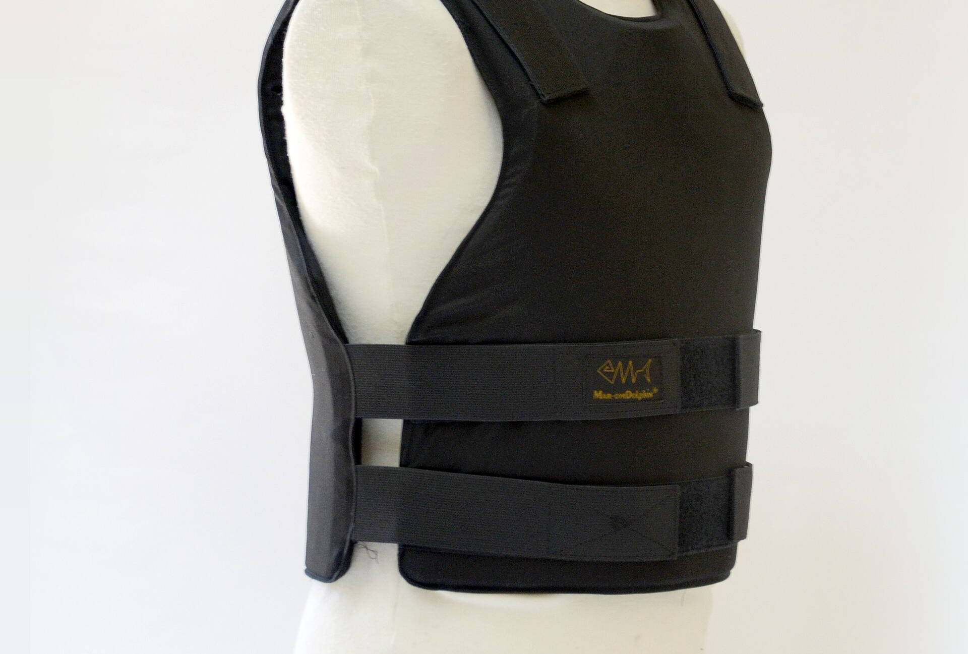
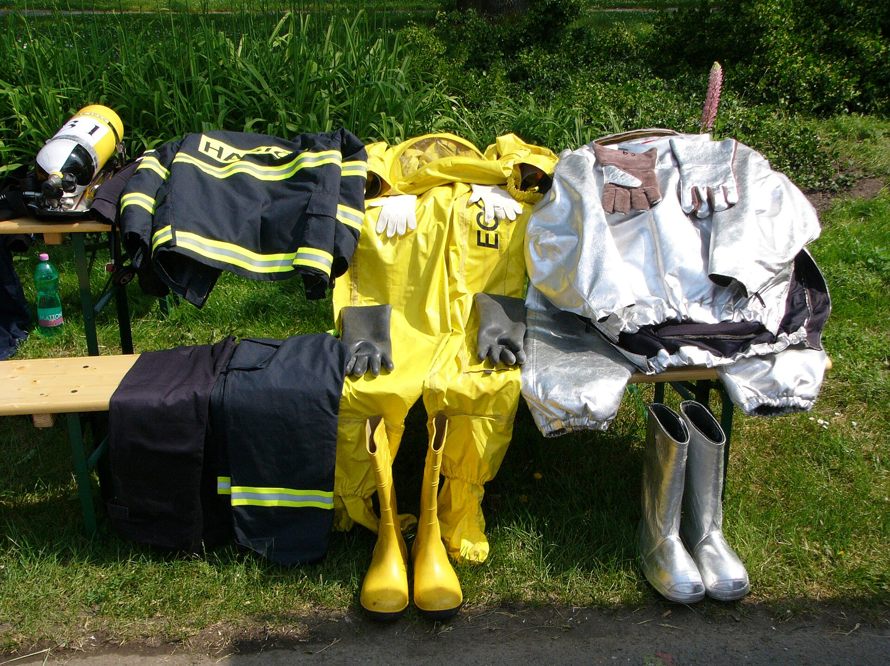

RATANMOTI
ADVANCE TEXTILE
WHY IT MATTERS
Three Real Failures — and the Defects Behind Them
Body armour that let a bullet through
IS 4726 · DEFECT ATLAS
A vest rated to stop the round simply didn't.
24 graded weave defects
THE CATCH · The weave looked perfect — the fibre had quietly lost a third of its strength.
Broken ends & picks · floats · slubs · snarls · abrasion · holes · smashes · weak places · pin-holes · biased & bowed filling · selvedge faults · width — each graded Major or Minor. In the live deck these rotate automatically beside the case studies.
A fire coat that looked fine
Retired gear had lost most of its protective strength.
THE CATCH · You can't see the damage — so gear is retired by age, not by looks.
One broken thread in a parachute
A single fault can start a tear across the whole canopy.
THE CATCH · That is why the safety standard counts every defect.
BHARAT TEX 2026 · ARAMID WEAVING
06 / 08

Slide 7
RATANMOTI
ADVANCE TEXTILE
THE RATANMOTI ANSWER
We Know How to Weave These Fibres
WE HOLD THE YARN IN ITS SAFE WINDOW
We don't force the fibre to fit the loom.
We build the loom around the fibre.
Tension is held exactly in the safe zone — too low and the yarn goes slack, too high and it snaps. We keep it just right, automatically.
PROVEN ACROSS EVERY HIGH-PERFORMANCE FIBRE
SAFE WINDOW
Para-aramid
Meta-aramid
Carbon
JUST RIGHT → clean weave, full strength retained
Glass
UHMWPE
Tension, climate and machine health under closed-loop control — on every metre we weave.
BHARAT TEX 2026 · ARAMID WEAVING
07 / 08

Slide 8
RATANMOTI
ADVANCE TEXTILE
Thank You
Questions & discussion
Ritesh · Ratanmoti Advance Textile · Bharat Tex 2026

